Slide 1

Big Cities Health Coalition
http://www.bigcitieshealth.org/
Team Members: Hasib, Brian Kramer, Jarrett Campbell, Stephen Seyer

Slide 2
5. Data/App Architecture
2. Business Objective
3. Data Manipulation
4. Coding Approach
6. Visualizations
7. Future Enhancements
1. Research Questions
8. Appendix
9. Q&A
Table of Contents:

Slide 3
Research questions
Are females more likely to die from breast cancer vs lung cancer?
How does the unemployment rate compare across ethnicities ?
Are men more likely to live longer than women?
What major city has the highest Spanish speaking population ?

Slide 4
Business Objective
The dataset we used provides healthcare, social and economical factors across 30+ major cities around the US. Purpose: The purpose of this website is to create informative visualizations based around the users selected data from the KEY INDICATORS. Users will use dropdowns on the website to drill down to what kind of data they want to see.
Visuals Chart Types: • Pie • Bar • Line • Scatter
For example: Any user visits that website can go in and select what data they want to see involving Maternal and Child Health, by selecting that from the indicator category. After selection, the indicator dropdown will populate with illnesses related to their selection. That will then populate the year dropdown with all the available years, the sex dropdown with available genders, race dropdown with available races, and finally the location dropdown. Once their selections are made, they can click the submit button. This will provide a list of available chart types that will display their data. If a user selects an indicator and only wants to break the data by sex, then a pie chart would be listed. If they are trying to compare multiple indicators across multiple locations, then we may propose a line chart.

Slide 5
Data Manipulation Issues
Data was missing primary key
Data size
ETL process
Application speed

Slide 6
Coding Approach
Website Design/ Layout
Speed Consideration
User experience

Slide 7
Data/App Architecture
App comprised of HTML,CSS,JS and PY file
Flask App framework
MySQL database
*un_zip library *

Slide 8
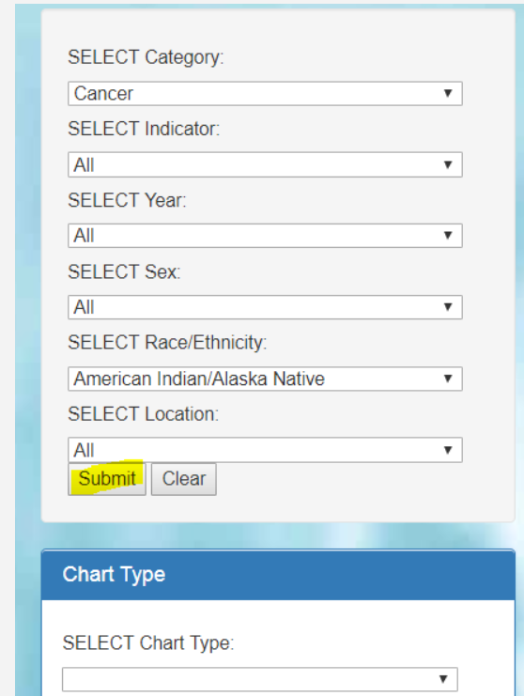
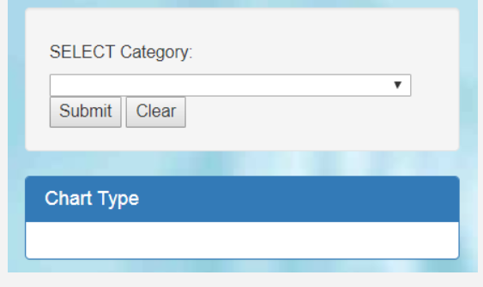
Visualizations

Slide 9
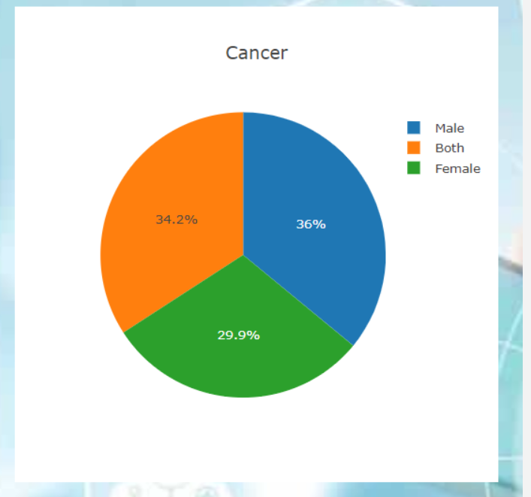
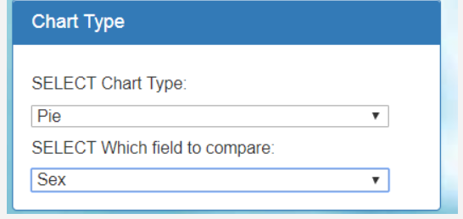
Visualizations

Slide 10
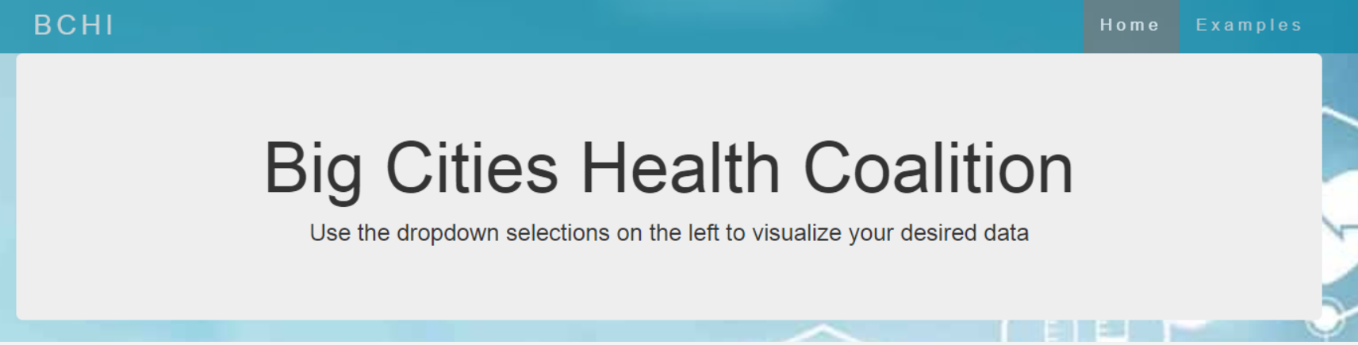
Visualizations

Slide 11
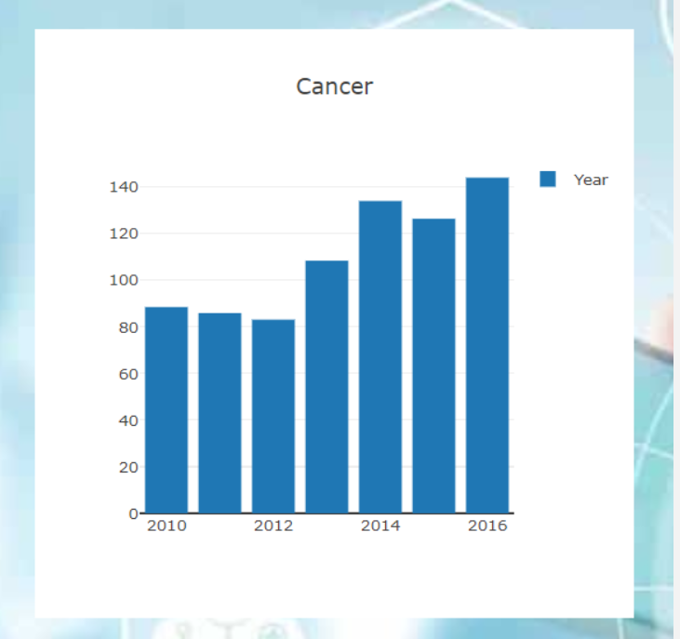
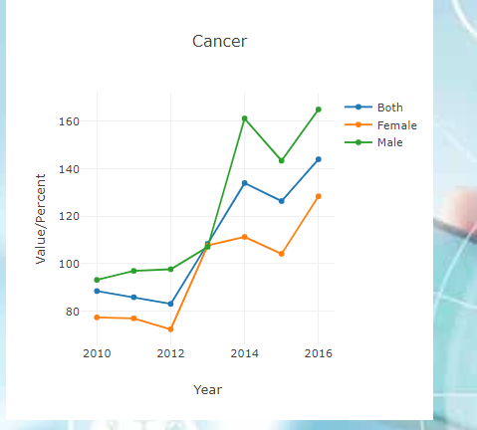
Visualizations

Slide 12
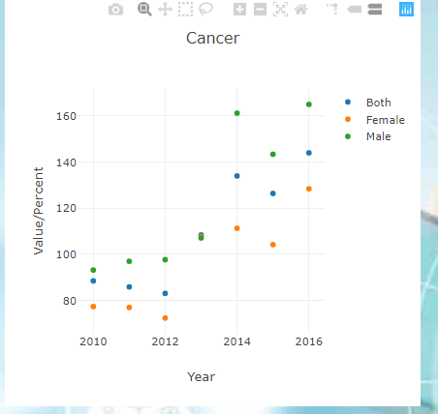
Visualizations
Live demo
Notes:
Live demo after visualization

Slide 13
Future enhancements…
Auto update individual selection
Year range
Additional chart types
Improved error handling

Slide 14
Appendix Page
http://www.bigcitieshealth.org/

Slide 15


